Slide 1

Diwygio Deddfwriaeth ar gyfer ADY/
ALN Reform
Notes:
Cyflwyno fy hun...Son am y dwyieithrwydd
Y ddeddf ADY yw'r system gymorth statudol newydd i blant a phobl ifanc 0 i 25 oed yng Nghymru sydd ag ADY. Daeth y system yma i rym ym mis Medi 2021. Felly fel ysgol prif-ffrwd yng Nghymru mae gennym ddyletswydd dros y 3 mlynedd nesaf i newid ac addasu ein systemau yn raddol.
Welsh Government is changing the way that children and young people with ALN will be supported. A new statutory support system for learners with ALN has been in place from September 2021. This new system for supporting children and young people with ALN will bring about several changes over the next 3 years to the way that young learners are supported.
Un o brif amcanion y ddeddf newydd yw i sicrhau bod y broses yn un symlach a chliriach i bawb. The system is changing for several reasons, but the main reason is to make the process simpler and more transparent for all people involved.
This is the reason that you have all been invited to attend this presentation this evening - we want to inform you of these changes from the start and ensure that you feel informed and supported along the way.

Slide 2
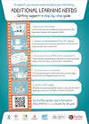

Bwriad y cyflwyniad /
The aim of this presentation ...
01
02
03
Notes:
Bwriad y cyflwyniad yma heddiw yw i wneud 3 pheth…
Rhannu gwybodaeth ynglyn a’r newidiadau i’r system ADY yng Nghymru
Son am sut mae hyn effeithio ar y ffordd rydym yn gweithredu fel cymuned i gefnogi plant gydag ADY (staff ysgol, rhieni ac asiantaethau allanol)
Rhannu gwybodaeth am yr adnoddau a’r wybodaeth sydd ar gael i chi fel rhieni
The 3 aims of this presentation are
To share information about the implementation of ALN reform in Wales
To explain the way in which these changes will effect the way we support our learners as a school community (school staff, parents and outside agencies)
To share information about the resources that are available to you as parents and to answer any questions

Slide 3

Notes:
An old video that was made by Welsh Government to explain the principles of the new ALN act

Slide 4





Main Principles of the new ALN ACT
01
02
03
04
05
Rights of the child and the parents
Same rights and entitlements whatever the age or setting
Single system
A fair and transparent system for all
Bilingual
Notes:
being learner-centred - that the rights of the child and the parents are respected as part of the system
•providing learners with the same rights and entitlements whatever their age or setting;
bringing together all current systems into a new, single system for ALN;
•being a fair, inclusive and transparent system for all
•providing Welsh language provision where needed

Slide 5
BWhat are the main differences at school?
The previous system
The new system
Around **% of pupils on the ALN register (this is different for every school)
2 levels - 1 Page profile
Register + IDP
Only pupils on the ALN register have an IDP
Possible that children with learning differences are not on the register if it is agreed that they do not need additional learning provision (ALP)
Around **% of pupils on the SEN register
3 Levels - SA, SA+, Statements
IEP for everyone on the register
A pupil with learning differences (e.g. ASD or Dyslexia) tended to be on the ALN register
Notes:
The term Special Educational Needs (SEN) has been replaced with Additional Learning Needs (ALN)
However, the definition of ALN is similar. It will cover pupils who
Have significantly greater difficulty in learning than the majority of the other pupils the same age or
Have a disability which can prevent or hinder them from making use of the facilities for education that are used generally for all other pupils

Slide 6
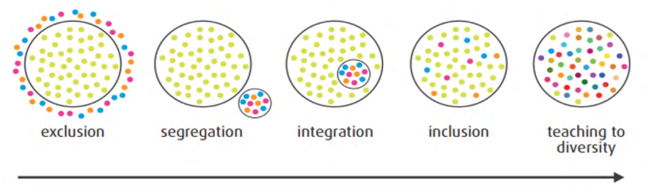
Inclusive classrooms for all
Notes:
We understand that this can be a scary thought for some parents - this will indeed mean that over the next few years less pupils will be put on the ALN register, and some pupils that have previously been on the ALN register may even be taken off the register if they do not need learning provision that is additional to or different from what is normally available at school. So what does this mean for us as a school?
On the first two INSET days in September I lead training for all school staff where we took time to think about this, and consider how we could ensure that our environment, our systems and our teaching was as inclusive as possible for all pupils.
The diagram in this slide was part of the discussion - if we look at this diagram as a representation of the pupils in our class we can see that “teaching to diversity” acknowledges that all our pupils are different and they need to belong to a community where differences are respected and planned for as part of our day to day teaching.
We focussed on
Differentiation and good modelling as standard practice
Effective use of staff and learning equipment to support learners in class on a daily basis
A focus on pupil wellbeing
Learning interventions being part of what is provided and managed by the class teacher and TA, not by the ALNCo - this has to be standard classroom provision, not addition learning provision (so your child does not need to be on the ALN register to have access to interventions)
This will be a big part of my role as ALNCo over the next 3 years
In brief, our focus will be on providing our learners with high quality but routine provision in class, and also on recognising a need as early as possible so that there is less need for intervention at a later stage for a number of learners.

Slide 7
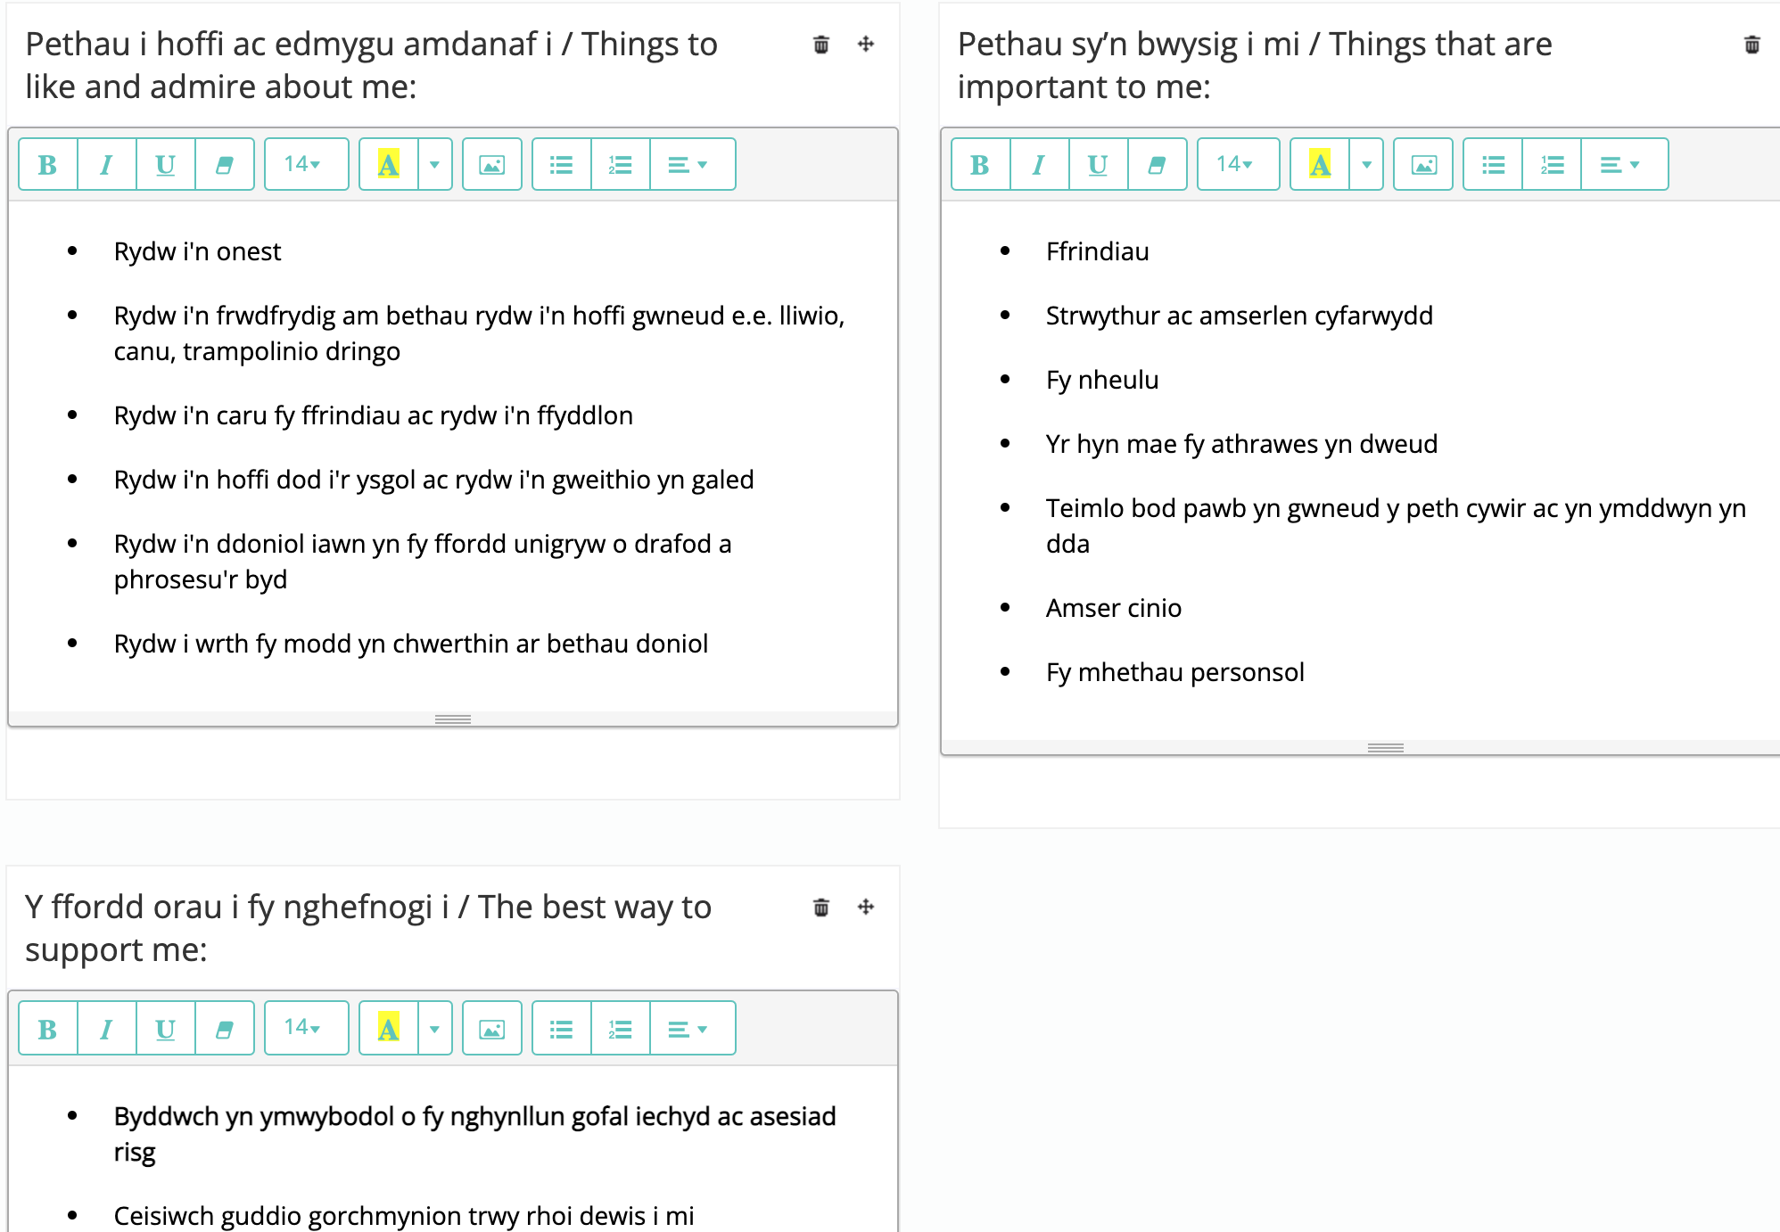
One page profile
Notes:
But what if what is usually available for everyone isn’t enough?
Unfortunately some children will fail to make expected progress and need something additional to or different from the universal provision for a short while (e.g. Speech and Language Therapy, advice and support from the Local Authority Emotional Health and Wellbeing Team for a few terms, a block of Theraputic Interventions from Health Practitioner).
Other children may need to be monitored more closely than others or may need the adults around them to be aware of specific adaptations that need to be made to the learning environment so that they can access what is usually available to everyone (e.g. a hearing aid, a risk assessment detailing physical adaptations that need to be made to the environment) or a specific type of provision that needs to be carried out by the class teacher and TA (such as a daily check in or an individual literacy or speech and language intervention).
At this point your class teacher will contact you to create a 1 page profile for your child.
This profile will include details about things that are important to your child and ways to support them.
It will also mean that they are monitored more closely and their profile will be shared with all the relevant school staff
This will not mean that your child is on the ALN register, but will mean that staff are aware of specific changes to the environment, resources or teaching methods that will enable your child to access what is usually available to everyone

Slide 8
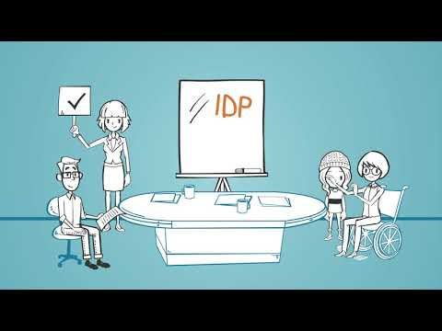
But what if I think my child has ALN?
Notes:
What if either a parent or the school thinks that a pupil has Additional Learning Needs
For some pupils these small adaptations to what are usually available are not enough. Some children need long term Additional Learning Provision that is additional to or different from what would normally be available to everyone. It is possible that these pupils have Additional Learning Needs and would need to have an Individual Development Plan that notes what Additional Learning Provision should be provided by the school.
The pupils that need an IDP fit the description of ALN noted earlier
During this academic year it is statutory for school to provide an IDP for any pupil that is on the Additional Learning Needs register in Reception, Year 1, Year 3 and Year 5 from January 2022 onwards.

Slide 9
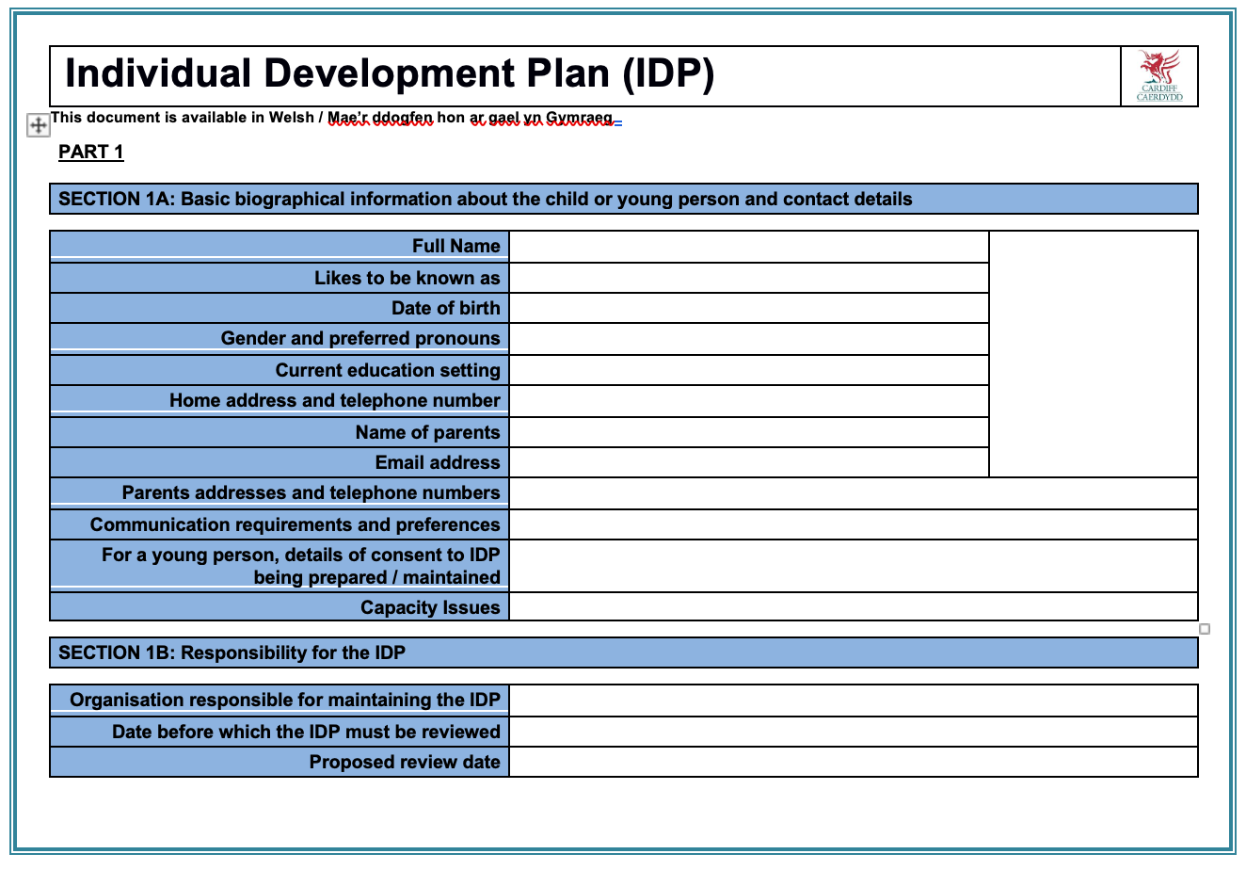
What is an IDP?
Notes:
Children on the ALN Registeralso have a 1 page profile - the same person-centered approach will be used for these pupils. The Individual Developmanet Plan includes a 1 page profile as part of the document.
Individual development plans (IDPs) will replace the existing statutory and non-statutory plans for learners.
•Children, their parents/carers and young people will be supported to understand and participate in the decisions which are taken that affect them, provided with appropriate reassurance, and offered opportunities to raise concerns and have their questions answered.

Slide 10
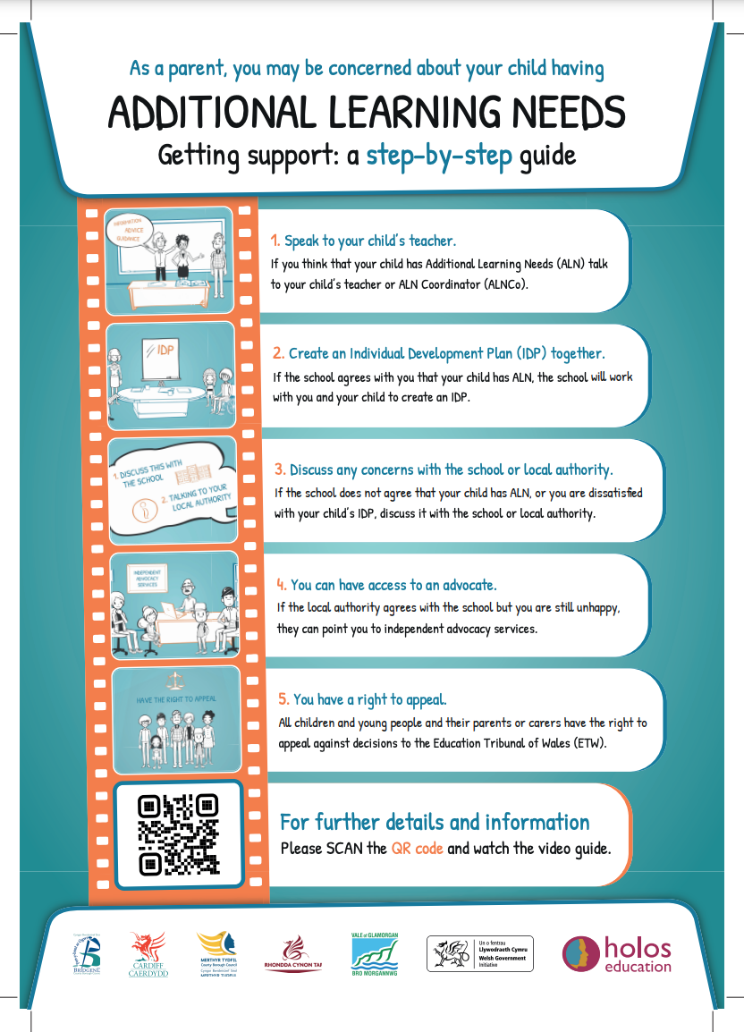

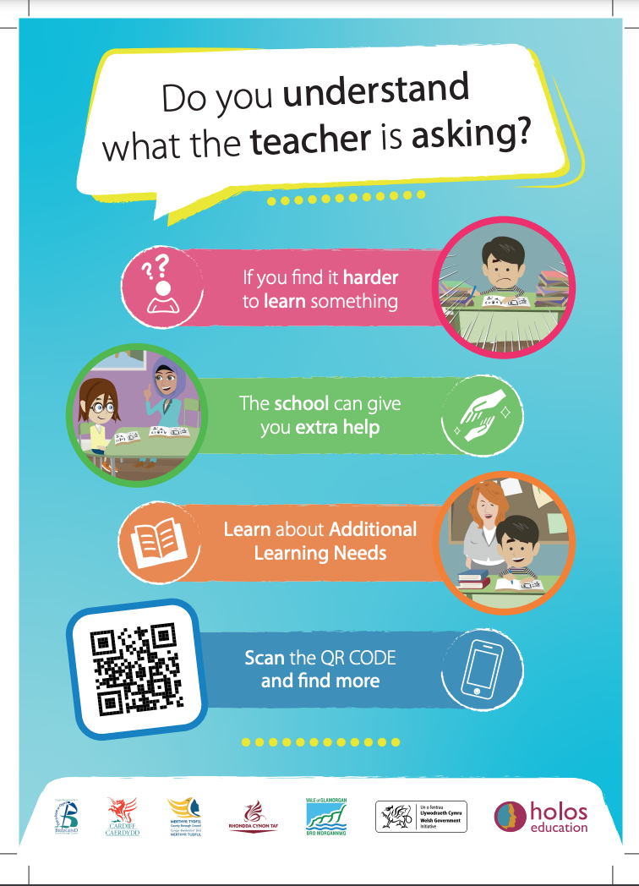
Further Information
Notes:
Central South Consortium have created several documents that will be shared on our website

Slide 11
Bwriad y cyflwyniad /
The aim of this presentation ...
01
02
03
Notes:
Son am y dwyieithrwydd
Bwriad y cyflwyniad yma heddiw yw i wneud 3 pheth…
Rhannu gwybodaeth ynglyn a’r newidiadau i’r system ADY yng Nghymru
Son am sut mae hyn effeithio ar y ffordd rydym yn gweithredu fel cymuned i gefnogi plant ADY (staff ysgol, rhieni ac asiantaethau allanol)
Rhannu gwybodaeth am yr adnoddau a’r wybodaeth sydd ar gael i chi fel rhieni os ydych chi eisiau gwybod mwy ac ateb cwestiynau
The 3 aims of this presentation are
To share information about the implementation of ALN reform in Wales
To explain the way in which these changes will effect the way we support our learners as a school community (school staff, parents and outside agencies)
To share information about the resources that are available to you as parents and to answer any questions

Slide 12
Any questions?

